Slide 1
HEALTHCONNECT
Final Analytics & Decision Support Package

Slide 2
The Problem
48.46% of scheduled appointments end in a no-show. Nearly half of all clinical capacity booked is never used.
This project set out to answer: which factors actually drive no-shows, and how can HealthConnect target interventions efficiently rather than applying a costly, clinic-wide fix?

Slide 3
DATA & KPIs
No-Show Rate
Reminder Effectiveness
Repeat-Offender Concentration
48.46%
4.03pp
72.43%
40% of patients drive this share of no-shows
Statistically significant, modest effect
2,423 of 5,000 appointments

Slide 4
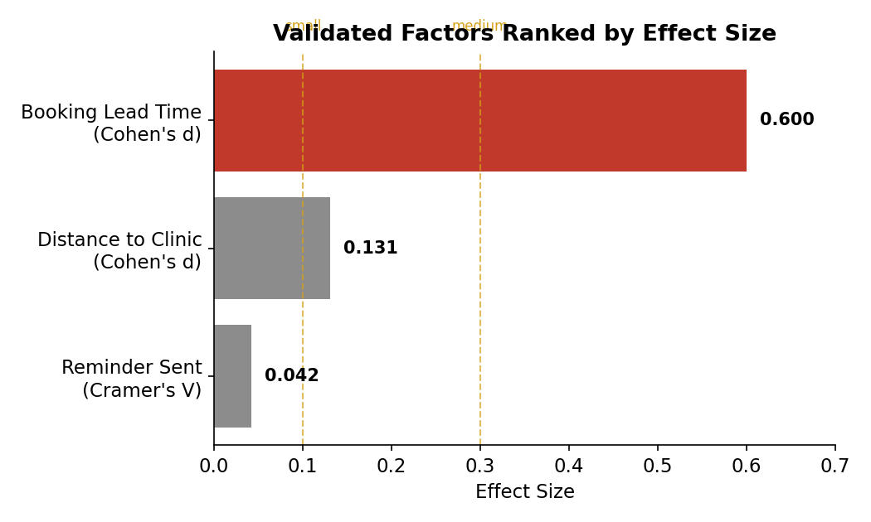
VALIDATED FINDINGS
Chi-square and t-tests confirm all three factors are statistically real
Booking lead time is the strongest validated driver (p=1.07×10⁻⁹⁰, d=0.60) far outweighing reminders and distance in practical effect.
Reminders and distance are statistically significant but practically modest real, supporting levers, not primary fixes.

Slide 5
No-Show Concentration
40% of patients (679 of 1,696) have 2+ prior no-shows.
They account for 72.4% of all no-show appointments. No-shows are concentrated, not evenly spread, supporting a targeted rather than blanket intervention.

Slide 6
BUSINESS INSIGHTS
Nearly half of scheduled capacity is lost to no-shows. A structural, not marginal, problem.
Booking lead time is the most actionable, statistically strongest driver.
Distance to clinic is a real but modest access barrier, pointing toward logistics-based fixes.
Reminders help but aren't sufficient alone. They’re necessary, but not sufficient.
No-shows concentrate in a definable patient group. A targeted intervention beats blanket policy.

Slide 7
RECOMMENDATIONS
Introduce a booking lead-time cap
Reduces both no-shows and cancellations.
Target repeat no-show patients directly
Extra confirmation steps for the 40% of patients driving 72% of losses.
Support distant patients with logistics fixes
Mobile clinic or telehealth for follow-ups, paired with reminders.
Continue reminders as a supporting measure
Real effect, but not sufficient as a standalone fix.
Track KPIs on an ongoing dashboard
Monitor No-Show Rate, Reminder Lift, and Repeat-Offender Concentration over time.

Slide 8
CROSS-TRACK COLLABORATION
Data Analytics ↔ Data Science
What I provided:
Validated findings (effect sizes + p-values) and a flagged data-quality issue in waiting_time_minutes.
What I received:
Guidance on which factors would strengthen the analysis for model-readiness, and confirmation that the booking lead-time finding was the most model-relevant result.

Slide 9
EXECUTIVE SUMMARY
HealthConnect loses nearly half its scheduled capacity to no-shows. Statistical testing confirms booking lead time as the strongest, most actionable driver, supported by a smaller but real influence from distance and reminders. No-shows concentrate in a definable 40% of patients, who drive 72% of the problem, making a targeted intervention strategy both effective and efficient.
Recommended next step
Introduce a booking lead-time cap and a targeted outreach program for repeat no-show patients.

